Slide 1
LIBRARY EVENTS
Fairley Elementary School
2015-2016

Slide 2
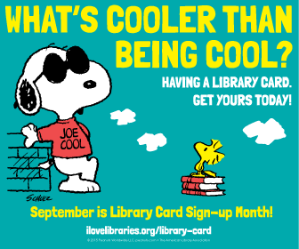
September 2015
Library Card
Sign-up Month

Slide 3
October 2015
Read for the Record
Book Fair

Slide 4
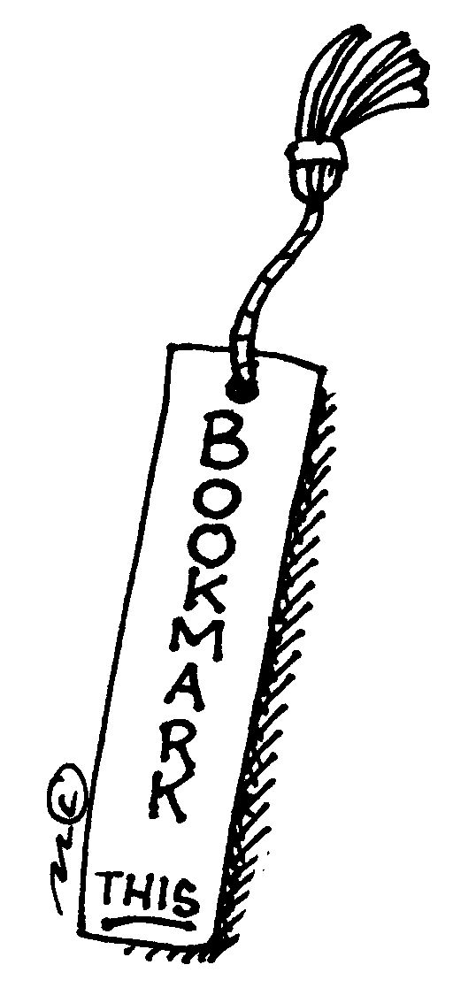
November 2015
Bookmark
Design
Contest

Slide 5
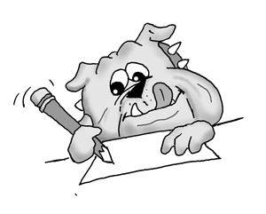
January 2016
Writing Contest

Slide 6
February 2016
Book War

Slide 7
March 2016
Read Across America (Dr. Seuss Day)
Book Fair

Slide 8
April 2016
Library Week

Slide 9
May 2016
Children’s Book Week

Slide 10
The ABC’s of Me (Ms. Smith)
B is for Books. Reading books is one of my hobbies.
J is for June. I was born on June 8th.
L is for Librarian. I am the Librarian at Fairley Elementary School.
P is for Pepperoni Pizza. I LOVE pepperoni pizza!
X is for X-Ray. The doctor took an x-ray of my wrist when I fell and broke it in December of 2013.

